Slide 1
Mastering Bitcoin Ch2-Ch4

Slide 2
Agenda
How Bitcoin Works?
Bitcoin Core: The Reference Implement (Installation guide)
Keys, Address

Slide 3
How Bitcoin Works?

Slide 4
Buying a Cup of Coffee
Alice has 0.1 BTC (10,000,000 Satoshi)
Buying a cup of coffee costs 0.015 BTC
Flow:
Alice send a transaction to Bob.
After Bob verifying the transaction, Alice got a cup of coffee.
1 BTC = 10^8 Satoshi

Slide 5
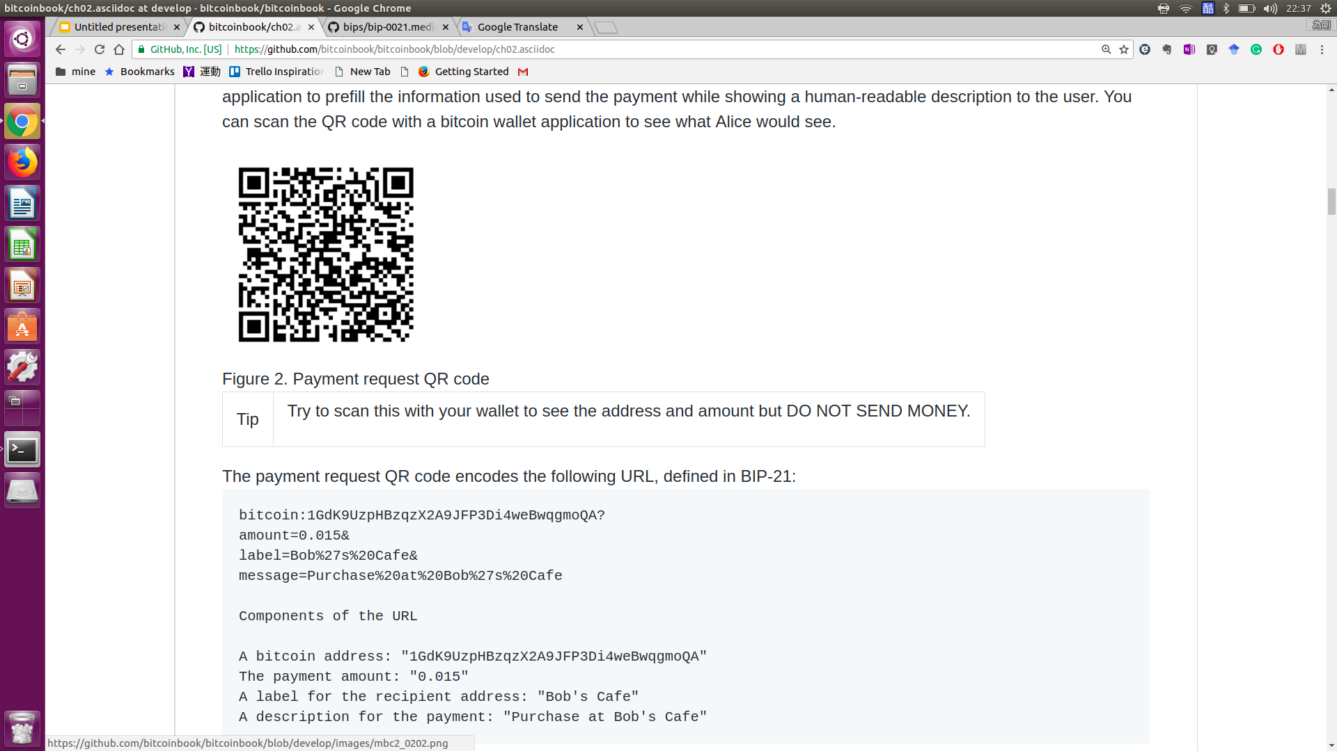
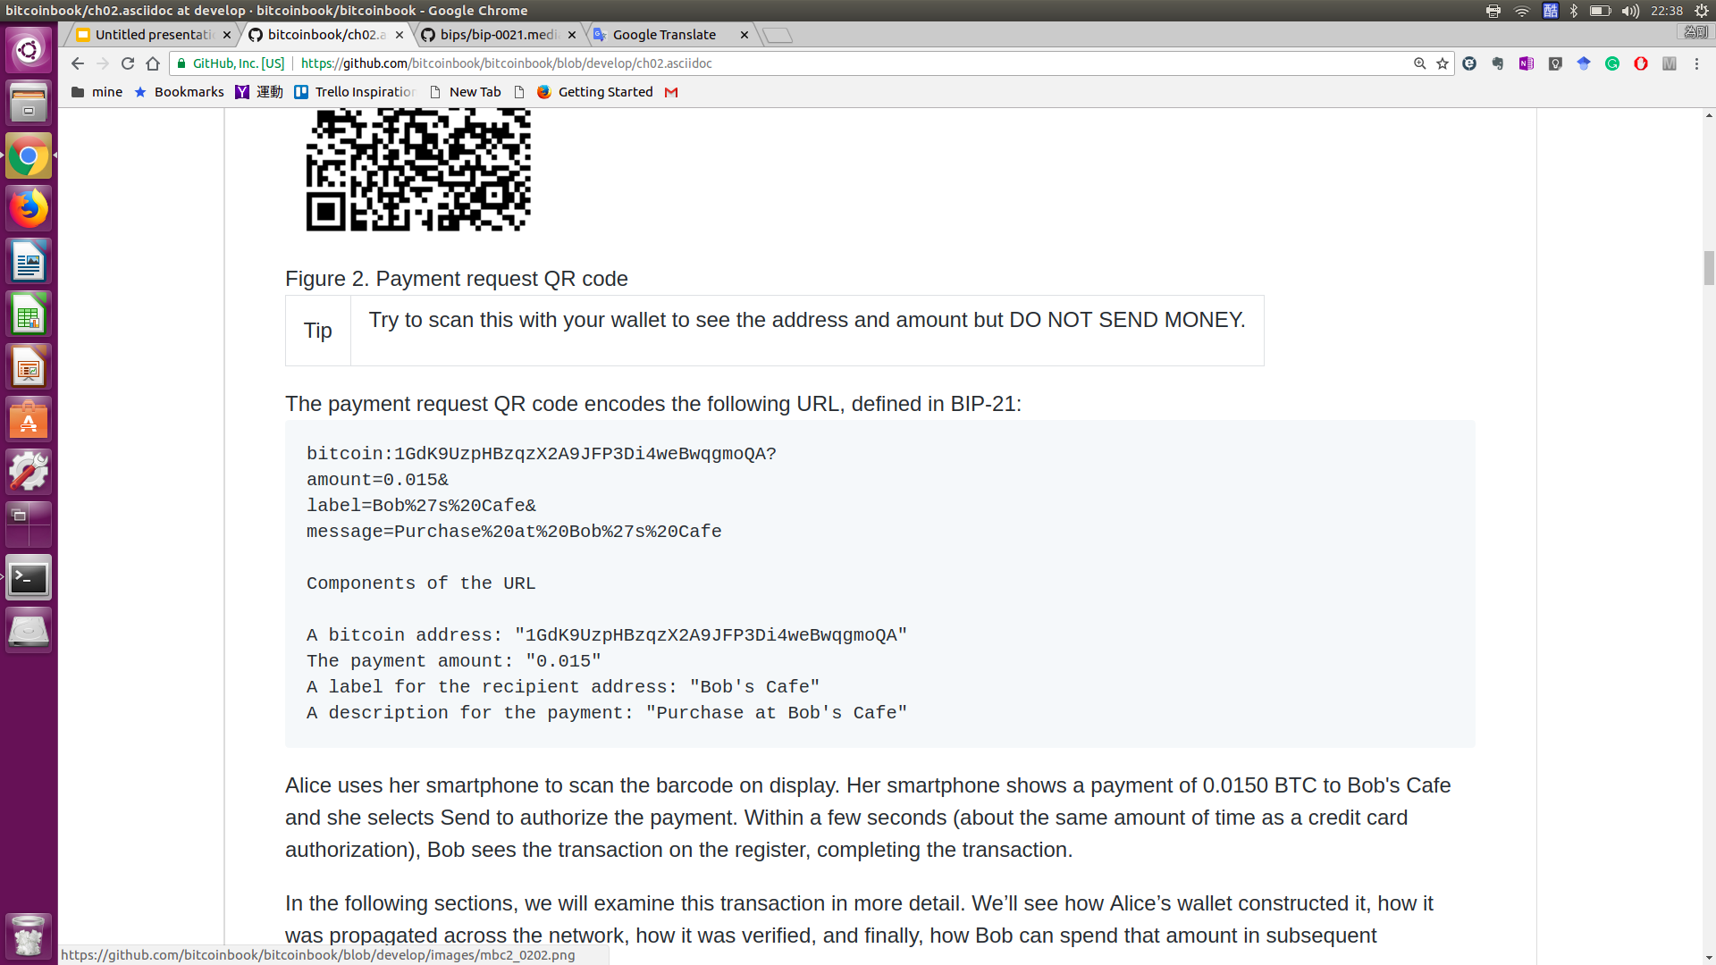
Transaction Input: Payment Request
Bip-21 Format:
A URI scheme for making Bitcoin payment
easily make payments by simply clicking links on webpages or scanning QR Codes.
Bitcoin Improvement Proposals (BIPs)
Notes:
Alice can scan the QR-code to display

Slide 6
Transaction
Alice's transaction
Input: Alice’s address
Two outputs:
Pay to Bob.
Pay to herself for change. (pay to change address)
Transaction fee:
Fee = Total Input - Total Output
Notes:
In bitcoin terms, "spending" is signing a transaction that transfers value from a previous transaction over to a new owner identified by a bitcoin address.

Slide 7
Bob’s View
Should Bob waits for bitcoin network to confirm the transaction?
A merchant may accept a valid small-value transaction with no confirmations, with no more risk than a credit card payment made without an ID or a signature, as merchants routinely accept today.

Slide 8
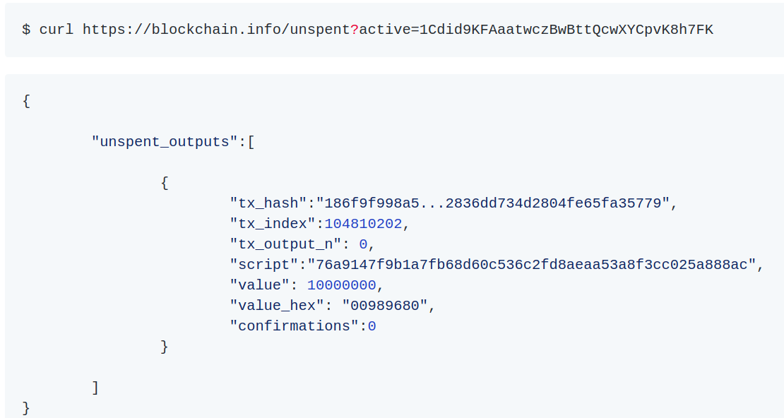
Discussion of Transaction
What is wallet software
Lightweight client: Keep track of all the available outputs belonging to addresses in the wallet
No copy: Ask a full-node using an application programming interface (API) call
Aggregate many small inputs, or use one that is equal to or larger than the desired payment.
Notes:
Like people handle the money

Slide 9
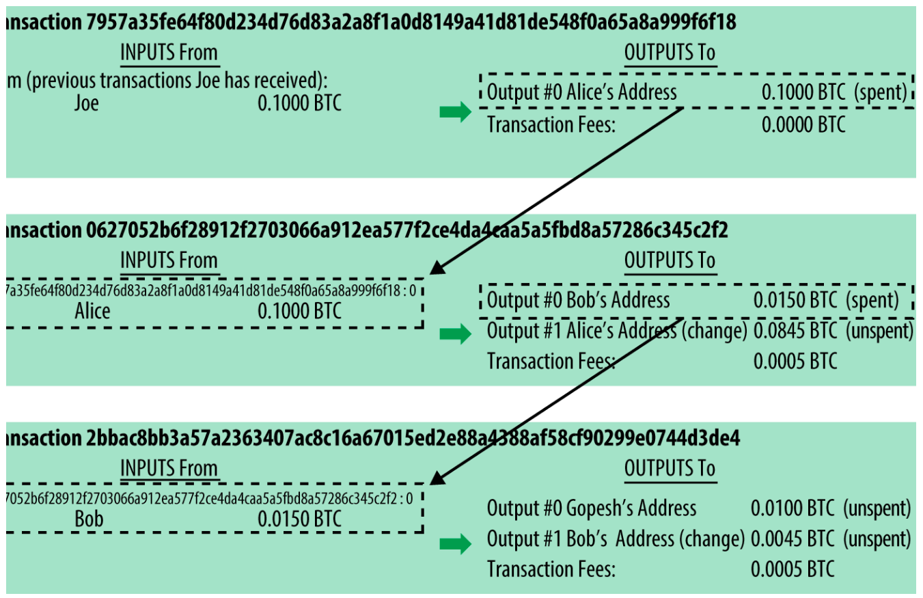
More and More Transaction: Transaction Chains
Alice gets bitcoin from Joe.
Alice buys a cup of coffee.
The inputs from the latest transaction correspond to outputs from previous transactions.

Slide 10
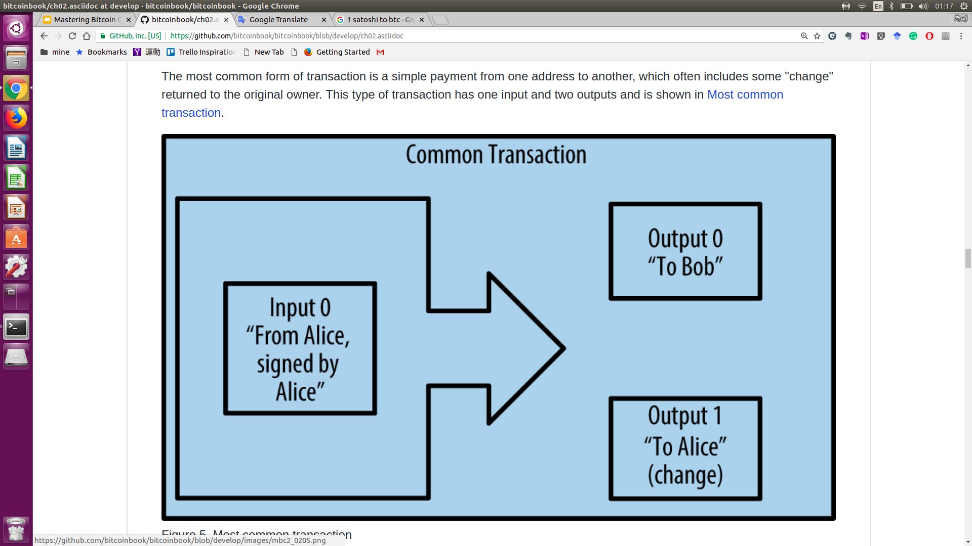
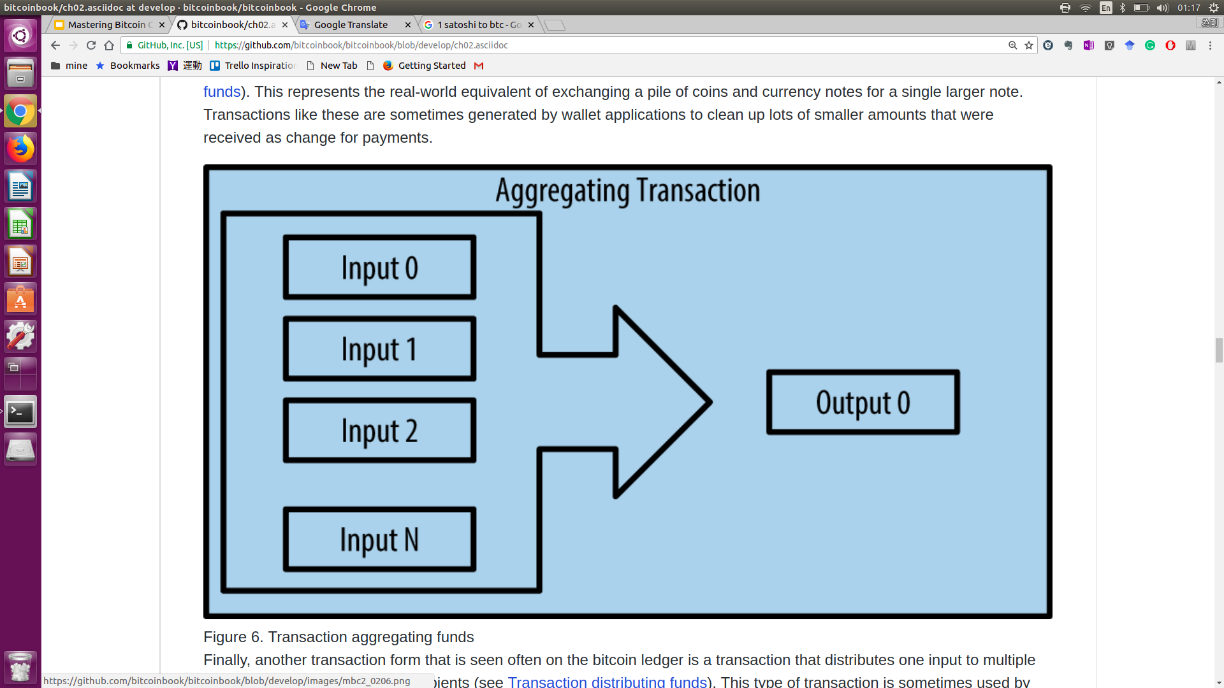
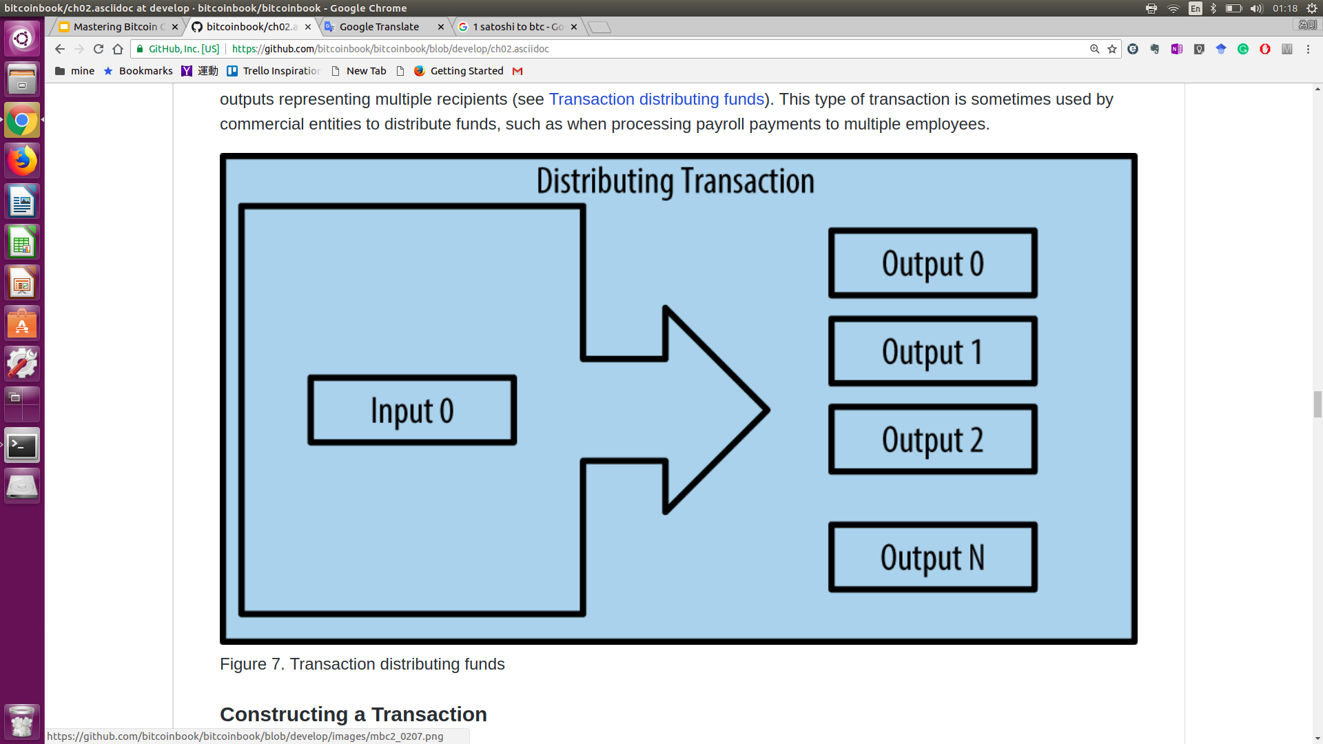
Bitcoin Transaction Types

Slide 11
Keys, Address
Notes:
前面講到地址，那鑰如何動用地址裡的錢，就是靠你手上的鑰匙，這章節介紹地址跟鑰匙之間有什麼關係以及那一種形式。

Slide 12
What are Key Pairs Doing in Blockchain Tech
Provide:
Decentralized trust
Control
Ownership attestation
Cryptography is not an important part of bitcoin.
Notes:
Cryptography is not an important part of bitcoin
對於key pair主要是提供對於自己資產的證明

Slide 13
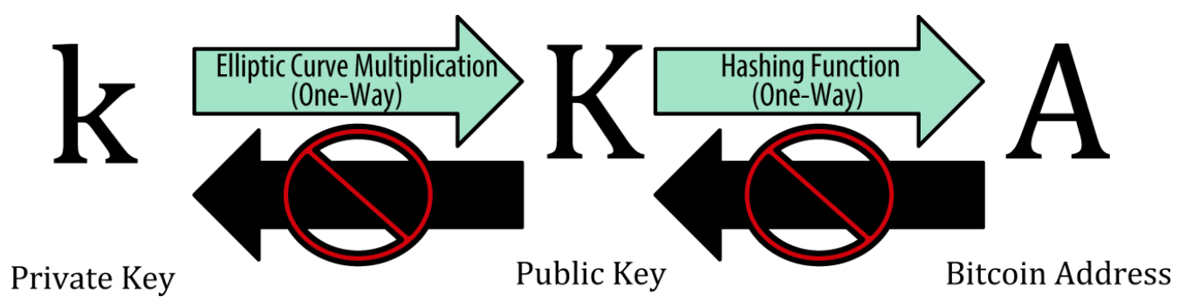
How to Generate Key Pairs
Pick a random number as a private key
Use elliptic curve multiplication to generate public key from private key
Use hashing function to get address

Slide 14
How to Generate Private Key
The private key is a number between 1 and 2^256 -1 (*256 bits)
Generate it by using:
Toss a coin 256 times (manually)
Feed a larger string of random bits into the SHA256 hash algorithm.
Do not use simple random algorithm.
* 256 nits is defined as the order of the elliptic curve
Notes:
SHA256:

Slide 15
Encrypted Private Key(Bip-38)
Motivation: safely store in the wallet.
User needs Password to activate the wallet.

Slide 16
Public Key
Elliptic curve multiplication:
K = k * G
K: public key; k: private key; G: generate point
k can be reversed by brute-force searching

Slide 17
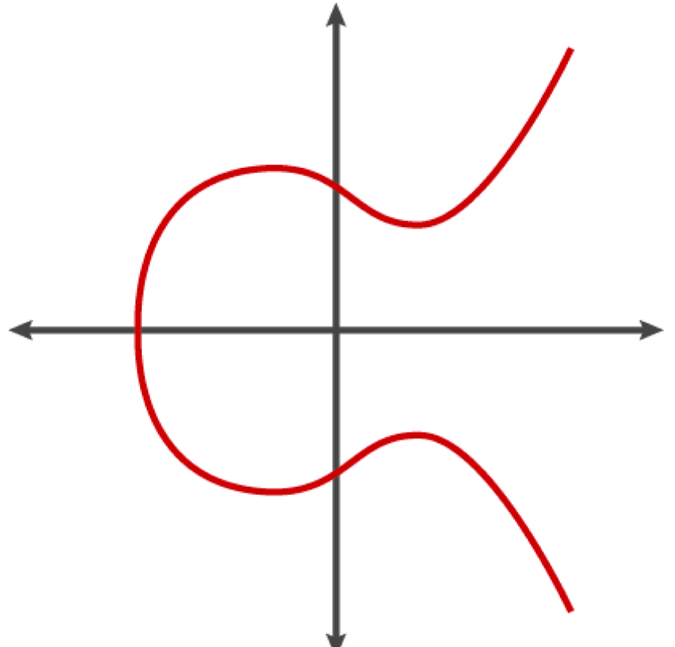
Elliptic Curve Cryptography
The secp256k1 Elliptic Curve:
y^2 = ( x^3 + 7) mod p
p = 2^256 - 2^32 - 2^9 - 2^8 -2 ^7 - 2^6 - 2^4 -1
Addition operator + in Fp
P3 = P1 + P2 is defined as:
Draw a line L between P1 and P2
P3’ is the only one point that L intersect the elliptic curve
P3 is the reflect of P3’

Slide 18
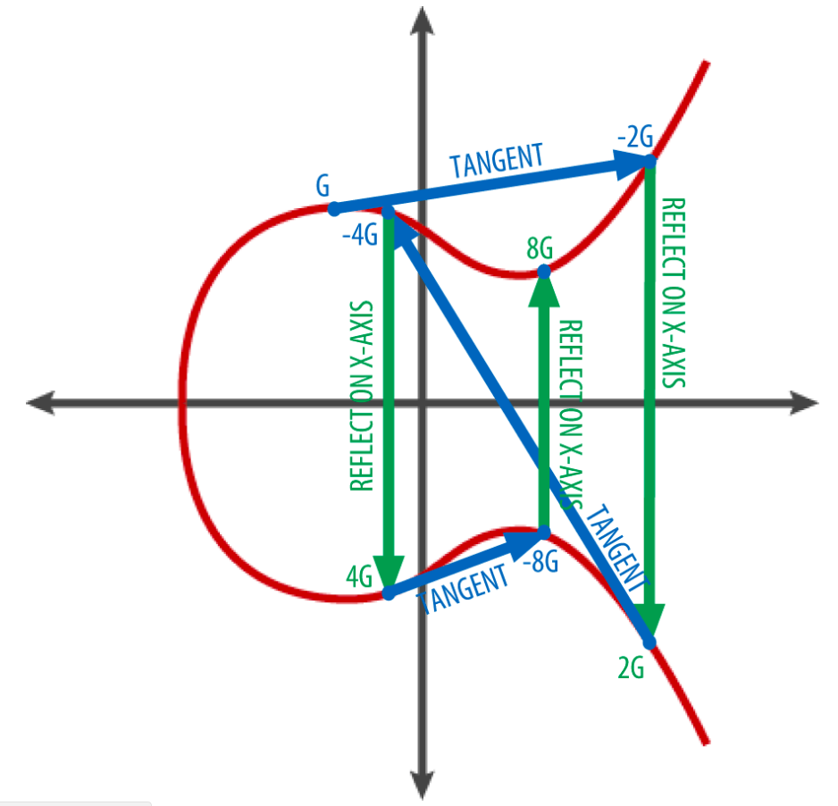
Example
K = k * G
K = G + G + G + ….
If P1 and P2 are the same point, L is extend to be the tangent on the curve.
The steps of generating public key:
Draw a tangent line L on the point
Find where L intersects the curve to derive P’
Reflect P’ on the x-axis to get next P
Finish util k times
The public key is: (04 x y)
Where 04 is prefix, (x,y) is the coordinate of K

Slide 19
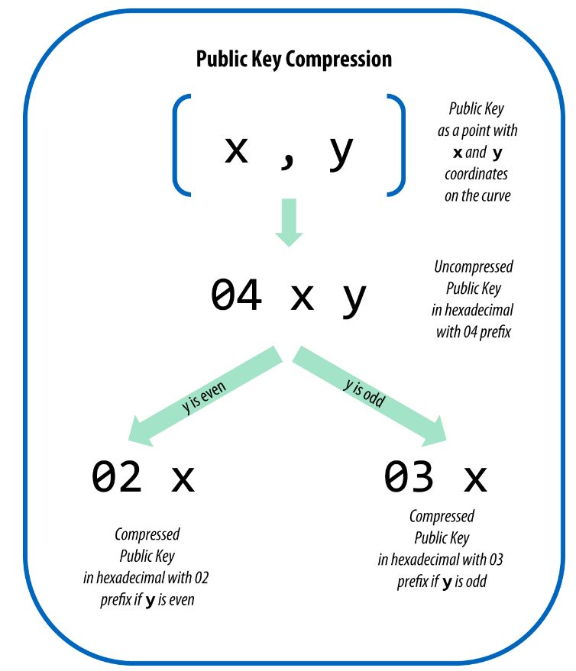
Compressed Public Keys
Motivation: reduce the storage size in every transaction. (almost 50% saved)
Compressed public key: prefix + the x coordinate of K
The y Coordinate can be derived by ( y^2 mod p ) = ( x^3 + 7 )
The problem is y can be positive or negative(use even and odd number to represent them)
We use prefix to store the sign of y
02: even number
03: odd number
How to deal with one private key to two public keys?
The bitcoin regards two public keys are different!

Slide 20
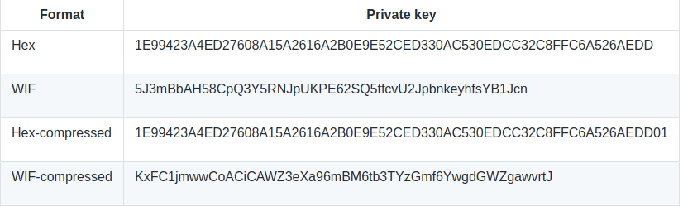
Compressed Private Keys???
No real "COMPRESSED” Private keys.
The compressed private key is the private key with a suffix to signify that the compressed private key should only be used to produce compressed public key.
Notes:
The compressed private key is longer than the original private key

Slide 21
Bitcoin Address
Bitcoin address is not the same as a public key, but it is derived from a public key using one-way function which is called pay-to-public-key-hash (P2PKH).
Bitcoin addresses are always encoded as Base58Check.
Base58 = Base64 - {“0”, “O”, “l”, “I”, “+”, “/”}
Base64: 26 lower and capital letters, 10 numbers, “+”, “/”
Base58Check = Base58 + error-checking code
Error-checking code is derived from the hash of the encoded data and can be used to detect and prevent transcription and typing error.

Slide 22
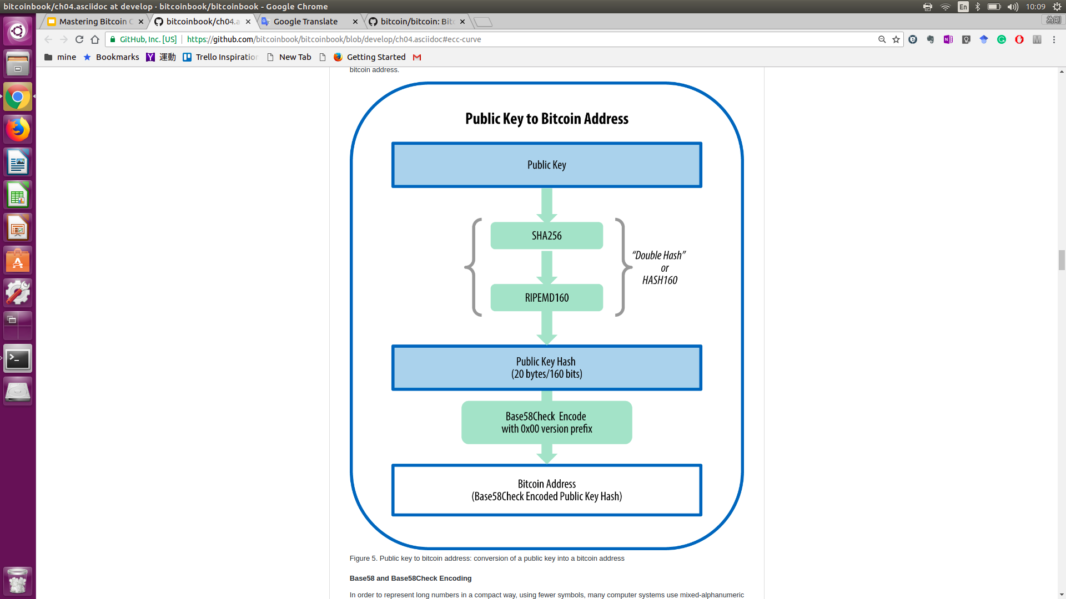
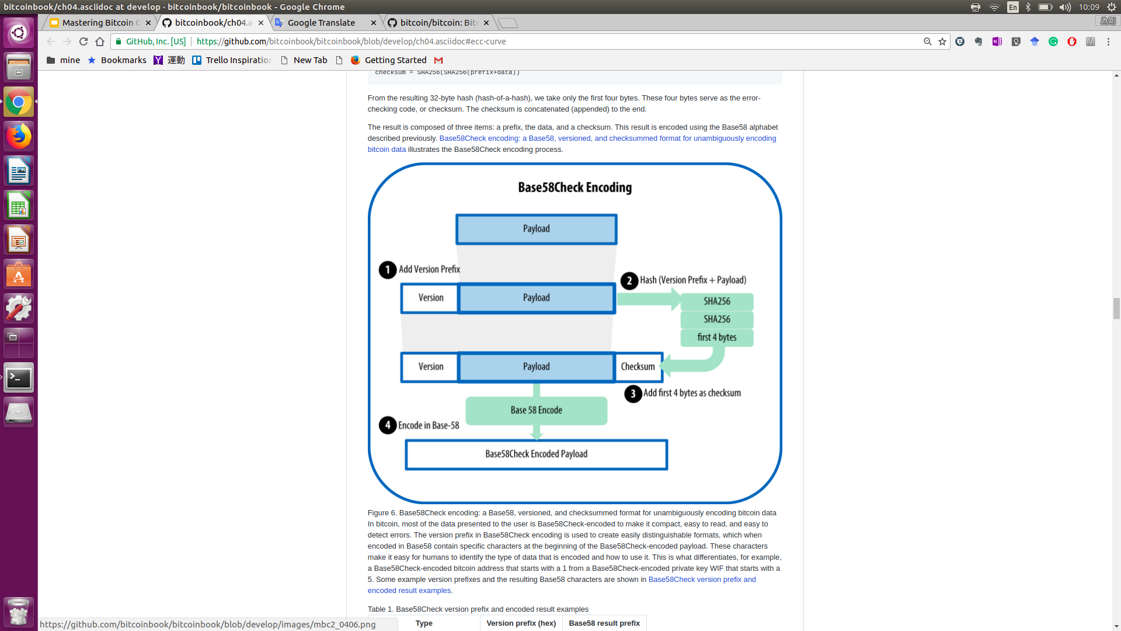
Bitcoin Address Flowchart

Slide 23
Further Reading
Pay-to-script-hash(P2SH)
Vanity addresses (special pattern addresses)

